Slide 1
JUSTICE IN VIEW INSTRUCTOR MATERIALS
A national teaching and research initiative designed by:
Dr. Amelia Frank-Vitale (Princeton U.), Dr. Lauren Heidbrink (CSULB), and Luis Guaman (Princeton U.)
Notes:
Welcome, everyone. In this video, we’re introducing Justice in View, a national teaching and research initiative designed to bring immigration court-watching into university classrooms
This project was developed by Dr. Amelia Frank-Vitale from Princeton, Dr. Lauren Heidbrink from CSULB, and Luis Guaman from Princeton. Together, we’ve created a framework that allows students to witness immigration law in action…not just as theory, but as lived practice.
Immigration courts are spaces where law, bureaucracy, and politics intersect in real time. By observing these hearings, students gain a deeper understanding of how power operates through tone, demeanor, delays, and discretionary decisions. This initiative is about cultivating critical thinking, ethical sensitivity, and civic engagement
Over the next few slides, we’ll explore the project’s goals, benefits for students, and practical steps for integrating court-watching into your courses

Slide 2

Project Overview
The Justice in View initiative integrates immigration court-watching into university curricula through structured training, guided fieldwork, and reflective classroom engagement.
Students observe live Master Calendar and Merits hearings.
Observations illuminate the intersection of law, bureaucracy, and politics.
A national network of observers enables comparative insights across courts and regions
Notes:
Let’s start with the big picture. Justice in View integrates immigration court-watching into university curricula through structured training, guided fieldwork, and reflective classroom engagement
Students observe live Master Calendar and Merits hearings in courts local to you. These are real cases, not simulations.
Observations reveal how law, bureaucracy, and politics intersect in everyday practice.
By connecting a national network of observers, we enable comparative insights across courts and regions.
This approach transforms abstract legal concepts into lived experiences, fostering critical thinking and civic engagement

Slide 3
Student Learning Goals & Benefits
Students will
Benefits of student engagement:
Develop a critical understanding of immigration law as lived practice, not just written doctrine.
Analyze how courtroom procedures, interpretation, and discretionary decisions shape outcomes.
Recognize how power circulates through tone, demeanor, delays, and administrative decision-making.
Understand the emotional and ethical dimensions of bearing witness.
Legal Socialization: Students see firsthand how due process is structured, circumvented, or reshaped by policy and discretion.
Research Skills: Students learn ethnographic methods—observation, thick description, qualitative data entry, coding, and analysis.
Civic Engagement: Students engage with the immigration system as informed witnesses, cultivating ethical sensitivity and professional responsibility.
Notes:
What do students gain from this experience? Actually, quite a lot.
They develop a critical understanding of immigration law as lived practice, not just written doctrine/law on the books
They analyze how courtroom procedures, interpretation, and discretionary decisions shape outcomes in cases
They recognize how power circulates through tone, demeanor, delays, and administrative decision-making.
They understand the emotional and ethical dimensions of bearing witness.
Benefits
Legal Socialization: Students see firsthand how due process is structured—or circumvented or shaped by policy and judicial or prosecutorial discretion.
Research Skills: They learn ethnographic methods—observation, thick description, qualitative coding.
Civic Engagement: Students engage with the immigration system as informed witnesses, cultivating ethical sensitivity and professional responsibility.
These experiences prepare students for careers in law, policy, advocacy, and research

Slide 4
The Instructor Toolkit includes:
A comprehensive Instructor Guide with course integration strategies
Survey Instrument
How to identify and contact courts
FAQs
Glossary of Terms
Student Agreement
Sample Syllabus
Sample letter for students to carry to observe
Suggested readings and media
Reflection and Assignment Prompts
Notes:
To facilitate integration into your courses, we have developed a comprehensive Instructor guide. This includes course integration strategies; Survey instrument and court contact guidance; FAQs, glossary of terms, student agreement, sample syllabus, sample letter for students to carry with them when the observe, as well as Suggested readings, media, and reflection and assignment prompts.
Doing community-engaged or project based learning is a LOT of work, so we hope these materials lighten the load, ensuring that faculty have resources needed to implement the project effectively

Slide 5
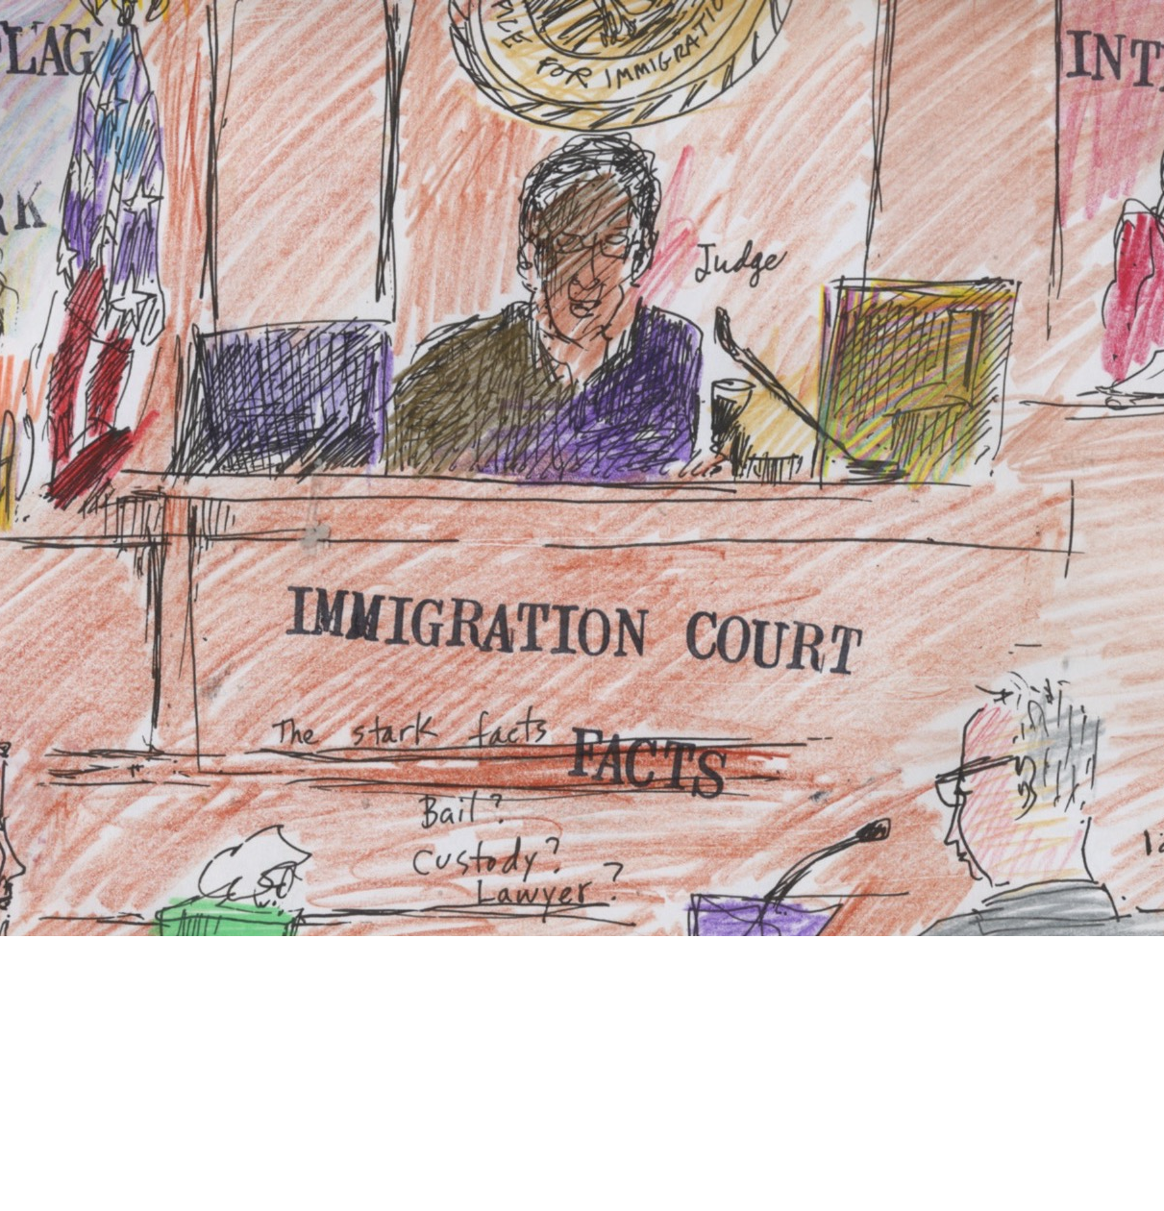
Incorporating Justice in View
As a class or a research lab
Require asynchronous training -> completion certificate
Assign at least 20 hours of observation (solo, pairs, groups, etc.)
Pair with readings on legal anthropology, bureaucracy, crimmigration, or human rights.
Incorporate reflective journals, group discussions, and case-based analysis.
Use survey data for in-class coding, comparative analysis, or final projects.
Faculty may connect students with national datasets to examine broader patterns.
Notes:
There are a variety of ways that you can incorporate Justice In View
As a class or research lab.
Require asynchronous training with quizzes corresponding to each module. Students receive completion certificate that they can submit to you indicating that they have compelted the training.
Generally, we encourage eyou to assign at least 20 hours of observation—solo or in groups. The first couple of times in immigration court can be overwhelming. A docket or two allows students to begin to observe the rhythm of the court and understand what they are seeing. That said, those initial hearings can help students begin to approximate how destabilizing or disorienting navigating a legal system in a foreign country and foreign language may be for those coming before the court, often without the assistance of an attorney
Whether in a lab or a course, we encourage you to pair with readings on legal anthropology, bureaucracy, crimmigration, or human rights.
You might include reflective journals, group discussions, and case-based analysis.
You can use survey data students generate (and which they receive an email copy) for coding, comparative analysis, or final projects.
You can also consider connecting students with national datasets to contextualze their experiences in court with broader patterns
This flexibility allows faculty to tailor the experience to their course objectives.

Slide 6
Training Requirements
Students complete an asynchronous interactive training that covers:
Basics of immigration law and the structure of EOIR
Ethical observation and non-intervention
Courtroom conduct and confidentiality
Safety and emotional preparedness
Courtwatching survey and data collection
Ethnographic courtwatching and fieldnotes
Students receive certificates upon successful completion of all module review quizzes and after signing the Immigration Research Hub - Student Agreement
Notes:
Before students begin observing immigration court hearings, students must complete a structured training. This ensures everyone understands the legal, ethical, and practical responsibilities involved
The training we’ve developed is asynchronous and interactive, covering several key areas:
Basics of immigration law and EOIR structure so students understand the system they’re observing.
Ethical observation and non-intervention reinforcing that our role is strictly observational.
Courtroom conduct and confidentiality to maintain professionalism and protect sensitive information.
Safety and emotional preparedness because these spaces can be intense and emotionally charged.
Courtwatching survey and data collection students learn how to record observations systematically.
Ethnographic courtwatching and fieldnotes introducing qualitative research methods for rich description
Students must pass all module review quizzes and sign the Immigration Research Hub Student Agreement. Once they do, they’ll receive a certificate confirming they’re ready to participate. They can provide you a copy of this certificate of completion.
I’ll add that this training isn’t just a formality. It’s what makes our work ethical, rigorous, and safe. It prepares students to enter the courtroom as informed, responsible observers

Slide 7
Student Safety
Why Safety Matters
Immigration courts operate within a heightened anti-immigrant political climate.
Federal agents—including ICE, DHS, and contracted personnel—may be present in waiting areas, hallways, and courtrooms.
Surveillance technologies (phones, facial recognition, biometric tools) may be in use.
Roles of Groups in Court
Multiple groups may be observing: faith communities, activists, legal advocates, accompaniment collectives.
These groups may follow different protocols, including supportive intervention.
Our project is exclusively observational and research-oriented.
Notes:
Immigration courts operate in a heightened anti-immigrant political climate. That means the spaces we enter are not neutral. Federal agents—including ICE, DHS, and contracted personnel—may be present in waiting areas, hallways, and courtrooms. Surveillance technologies like phones, facial recognition, and biometric tools may also be in use. So, we need to be aware of the environment and act accordingly
Roles of Groups in Court: You and your students may notice other observers—faith communities, activists, legal advocates, accompaniment collectives. These groups often have different protocols, and some may engage in supportive intervention. As we discuss in module 4 on safety and the ethics of care, our project is different. We are exclusively observational and research-oriented. That distinction matters because it shapes how we behave and how we’re perceived.
Safety is about more than following rules—it’s about respecting the boundaries of our role and protecting ourselves and the integrity of the research. We hope you and your students this front of mind every time you enter a courthouse

Slide 8
Non-Intervention Commitments
Non-Intervention Expectations
Students must never intervene, advise, or interact with respondents regarding their case.
Do not approach judges, attorneys, clerks, interpreters, or federal agents unless directly addressed.
Non-intervention is essential for legal, ethical, and personal safety.
Risks of Not Complying
Students could be removed from court or banned from the courthouse.
Intervening may jeopardize respondents’ cases.
Students risk drawing the attention of federal agents, which may have immigration or security implications.
Alternative Pathways
Students who wish to engage in accompaniment, advocacy, or mutual aid can be connected with community partners outside this research project.
These forms of engagement are important—but distinct from the goals and ethics of this court-watching initiative.
Notes:
Non-Intervention Expectations: Students must never intervene in a respondent’s case. That means no offering advice, no interacting with respondents about their situation, and no approaching judges, attorneys, clerks, interpreters, or federal agents unless they speak to you first. This is essential for legal, ethical, and personal safety.
Risks of Non-Compliance: If these guidelines aren’t followed, students could be removed from court or even banned from the courthouse. More importantly, intervening could jeopardize someone’s case and draw unwanted attention from federal agents, which can have serious immigration or security implications.
Alternative Pathways: For those who feel strongly about advocacy or accompaniment, we absolutely support those commitments—but they must happen outside this research project. We can connect interested students with community partners who do that work. Our initiative is strictly observational and research-oriented.

Slide 9
Documentation & Data
Students complete:
A structured Qualtrics survey following each observation.
Ethnographic fieldnotes describing tone, atmosphere, and affect
Students will receive a copy of their entries via email to submit
Faculty and students can use datasets to support research papers, capstone projects, or public-facing publications.
Notes:
Data collection is systematic and structured
Students complete a Qualtrics survey after each observation. They are oriented to this instrument in Module 5.
They write ethnographic fieldnotes capturing tone, atmosphere, and affect.
Submitted entries are emailed to students so you can ask them to submit their fieldnotes to you as an assignment or for collective use.
Faculty and students can use datasets for research papers, capstones, or publications.

Slide 10
Support for Faculty Integrating Court-Watching
Instructor Toolkit & Training Resources
One-on-One Consultations on Course Integration
Guest Lectures (Virtual or In-Person)
Monthly Debrief Sessions for Faculty & Students
Notes:
In addition to the full suite of materials, including instructor and student guides, training modules, and teaching resources to make implementation seamless….we also are happy to schedule one-on-one consultations to tailor the project to their course objectives.
Additionally, we offer in-class presentations or guest lectures—either virtually or in person—to introduce students to the initiative.
Finally, we host monthly debriefing sessions for both students and faculty. These sessions create space for reflection, troubleshooting, and sharing insights across campuses, ensuring that the experience remains ethically grounded and pedagogically rich

Slide 11
Institutional Research Board
IRB Approval Secured
Ethical Research Protocols
Data Use for Assignments
De-Identification Required
Additional Research → Your IRB
Notes:
The Justice in View project have been approved by the CSULB Institutional Review Board (IRB). This means the project meets federal and institutional standards for protecting participants and ensuring ethical research practices.
Students and instructors will receive copies of the observation data they generate, which can be used for course assignments as long as all identifying information is removed.
If faculty want to go beyond the scope of this initiative—such as publishing analyses with students or collecting additional data—they must check with their own institution’s IRB for further approval. This ensures that any extended research remains compliant and ethically sound.

Slide 12
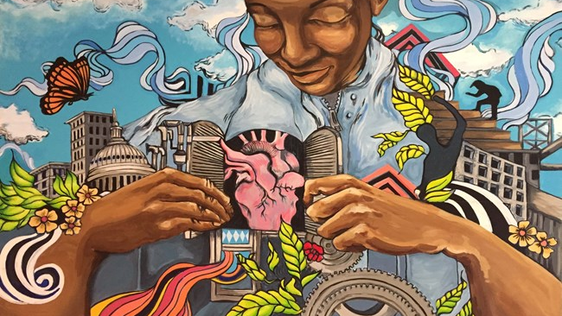
Thank you.
Notes:
Thank you for your commitment to experiential learning and justice-oriented education. Together, we’re building a network of informed, ethical observers who can illuminate the realities of immigration law.

